Slide 1
BLOCKCHAIN
--Distributed Ledger

Slide 2
Introduction
Staurt Haber & Stornetta release white paper(it includes what is blockchain & how to works)
Blockchain 1.0
In 2009,Satoshi Nakomoto implemented crypt currency( bitcoin) using blockchain technology
Blockchain 2.0
In 2015,Vitalik Buterin developed decentralised application using blockchain technology
Blockchain 3.0
IBM started developing Hyperledger Fabric

Slide 3
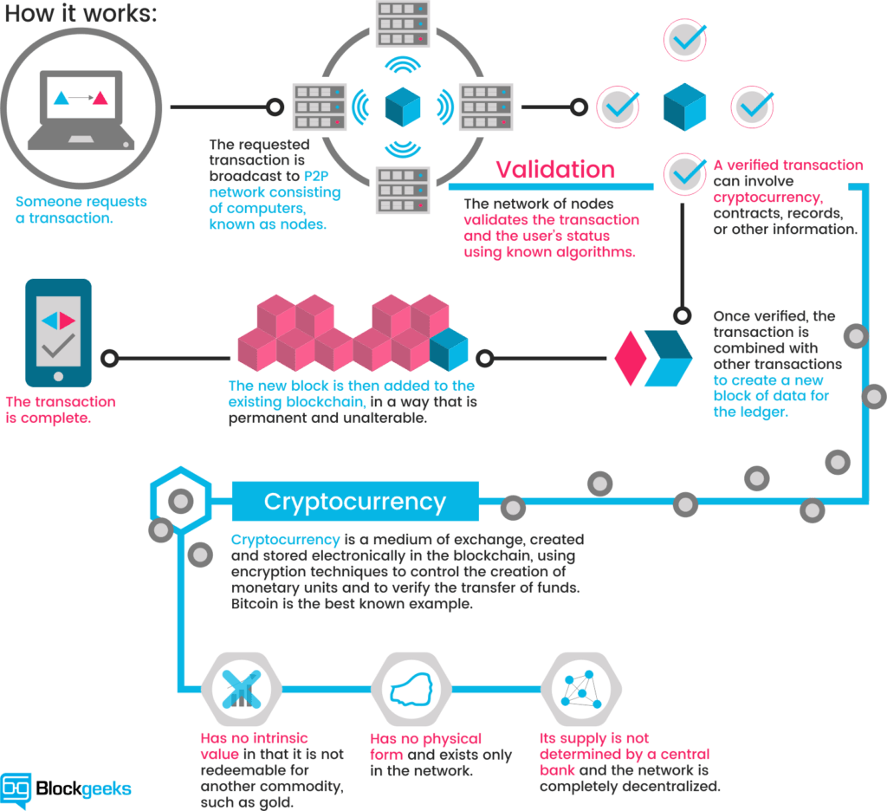
Transaction using Blockchain

Slide 4
How the blocks are stored in blockchain
Blockchain is a collection of blocks
Block also stores reference to previous block
Block also stores timestamp
Block0 hash Block1 hash Block2 hash

Slide 5
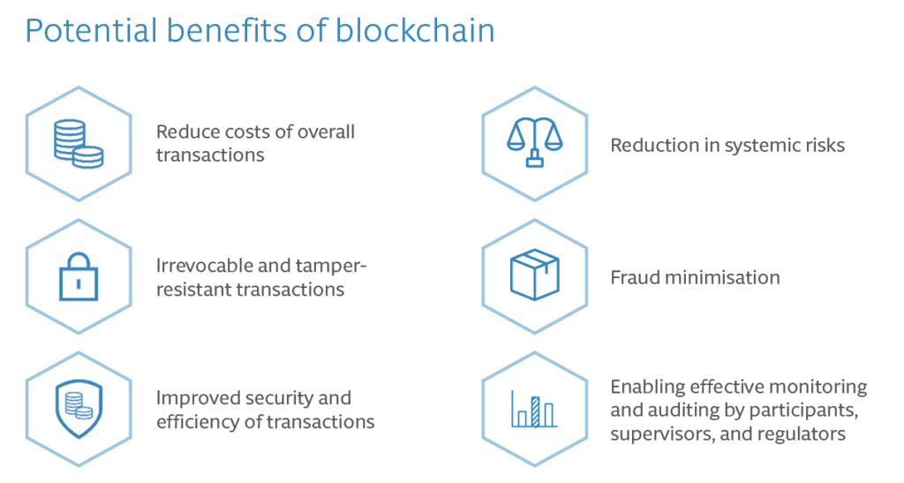
Benefits

Slide 6
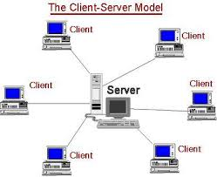
Network?
persent scenario of netwok world is “client-server network”
client-server network:

Slide 7
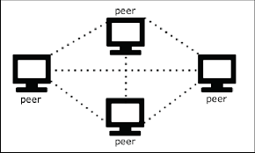
Peer to Peer network:
In peer to peer network we have only node/peer
Every node can have access to other nodes

Slide 8
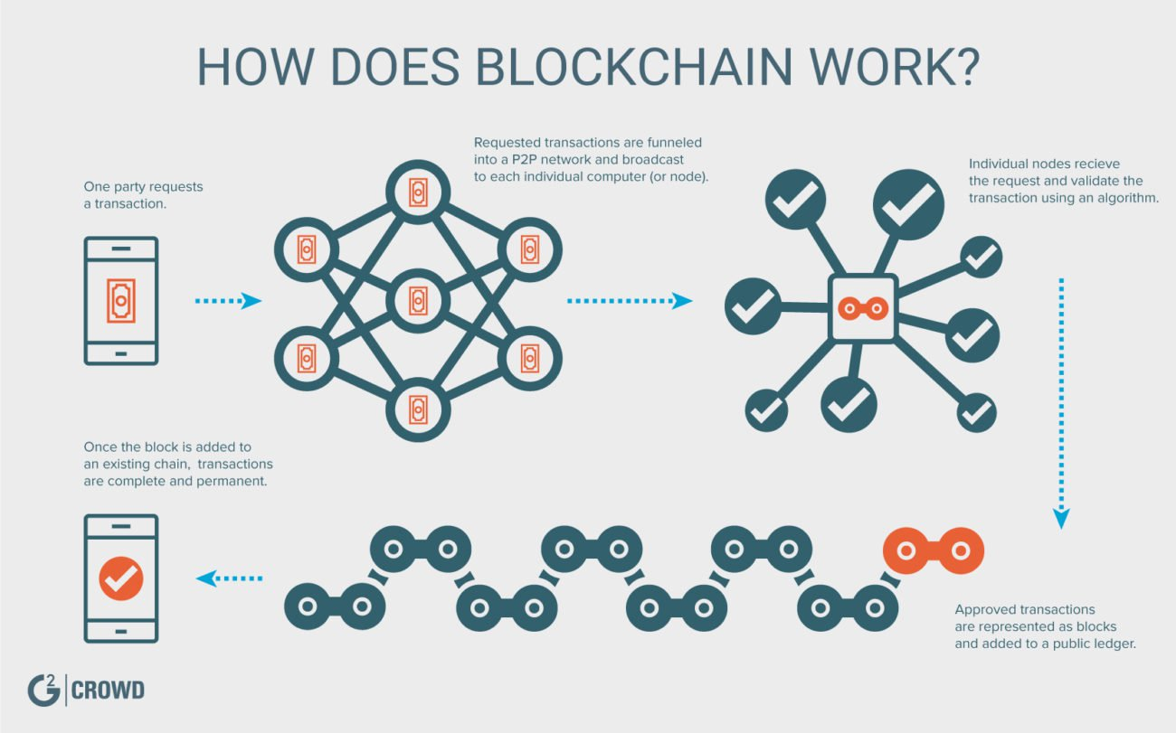
Implementation:

Slide 9
Features:
peer to peer network
decentralised
immutable
security
data avaliability
reduces memory

Slide 10
Usecases:
trading
healthcare
IOT etc..

Slide 11
summary
block chain makes data more secured
it reduces usage of memory
Researchers and technologists alike are talking about how blockchain technology is the next big thing across industries from finance to retail to even healthcare.

